Slide 1

Transforming Poultry Management throught the Fusion of Cutting-Edge Technologies: A Robust Approach to Secure Poultry Insight with Integration of IoT and Blockchain
KKR & KSR INSTITUTE OF TECHNOLOGY & SCIENCES
Guided by : Mrs. P. Neela Sundari
Assistant Professor , Dept of CSE
Submitted by :
D. Bhavana Sai 20JR1A0519
B. Revathi 20JR1A0509
Ch. Tanuja 20JR1A0511

Slide 2
TABLE OF CONTENT
Abstract
Introduction
Literature Review
Disadvantages of the Existing System
Technologies of Proposed system
Potential Users
Unique features of the System
Requirement Analysis
Functional requirements
User requirements
Non functional requirements
System requirements

Slide 3
ABSTRACT
This project aims on the application of Internet of Things (IoT) and blockchain technology in poultry industry. Production of poultry is highly depending on the environment parameters like temperature, humidity, air and lighting to maintain and to boost the production of poultry. Monitoring all the environmental parameters is crucial for a large poultry farm, especially in traditional way.
Recently, the adoption of IoT and Blockchain is used for monitoring and controlling the farm automatically. At first, the temperature is monitored using IoT-based sensors. All the stakeholders involved in the poultry industry will be registered on the Blockchain, and they will be required to record the relevant information on the shared, immutable ledger. Since storing the entire supply chain data on Blockchain is very costly, distributed off-chain file storage IPFS is used.

Slide 4
INTRODUCTION
The operation of poultry farm is tremendous and limited when using manpower, especially in a large farm. As the environment of poultry farm has to monitor regularly, farmers need to inspect all the environmental parameters manually. Therefore, with the implementation of IoT in poultry farm, it could reduce cost, manpower and is highly manageable. Blockchain is a digital ledger in which transactions made are recorded chronologically and stored publicly in chain of blocks which are produced through cryptographic algorithms. Commonly blockchain is the engine behind the cryptocurrency that ensures the integrity of the data in a decentralized and secured way.

Slide 5
LITERATURE REVIEW
I)Blockchain-based Poultry Information Management System Design and Implementation using Hyperledger Fabric
Proposed By Aliyu Ibrahim et al[5] - Article in Journal of the Chosun Natural Science(August 2021)
This paper presents blockchain-based poultry information management system design and implementation using Hyperledger Fabric. The system's main tasks include recording the information associated with poultry rearing (from a hatchery to a farm), and status reports of the farm activities on a monthly basis. The ability to trace the source of livestock products through all the stages of rearing/production, processing, and distribution is essential for ensuring food safety as recall of contaminated products can easily be done thereby increasing consumer confidence.
II) A smart IoT-based monitoring system in poultry farms using chicken behavioural analysis
Proposed By Mohammed Mostafa Ahmed et al[2]
This paper proposes a smart poultry monitoring system that leverages IoT sensors to detect and monitor chicken behavior in poultry farms and provides valuable information to industry stakeholders for management decisions and individual poultry health status. An optimized synthetic minority over-sampling technique (SMOTE) via an artificial hummingbird algorithm (AHA) is applied to solve the data imbalance problem.
DEPARTMENT OF COMPUTER SCIENCE AND ENGINEERING
5

Slide 6
LITERATURE REVIEW
III) A Preliminary Study on Poultry Farm Environmental Monitoring using Internet of Things and Blockchain Technology
Proposed By Mohammad Naim Elham et al[6]
At first, the data of temperature are monitored using IoT-based temperature and humidity sensors and recorded in JSON format. From the results, the data is successfully transmitted to the IOTA blockchain. Blockchain will ensure the data is secured and transparent to consumers. Recently, the adoption of IoT and Blockchain has been used for monitoring and controlling the farm
automatically. It is proven that it can reduce costs and the poultry farm well-managed.
IV) Blockchain applications in Poultry Industry
Proposed By Techskill Brew in 2022
All the stakeholders involved in the poultry industry will be registered on the Blockchain, and they will be required to record the relevant information on the shared, immutable ledger. Since storing the entire supply chain data on Blockchain is very costly; thus, distributed off-chain file storage IPFS is used. Precisely, entire supply chain transactions data will be stored on the off chain file storage IPFS and the hash of the uploaded data, along with its address, will be stored on the smart contract of Blockchain. Anyone knowing the hash of the file can retrieve the information from IPFS.
DEPARTMENT OF COMPUTER SCIENCE AND ENGINEERING
6

Slide 7
PROBLEM IDENTIFICATION
Identifying problems in a poultry management system that can be addressed through the implementation of blockchain technology involves understanding the existing challenges and potential areas for improvement. Blockchain provides a decentralized and tamper-resistant ledger that ensures data integrity. Each transaction is recorded in a block, and once added, it becomes extremely difficult to alter. This enhances transparency and trust among stakeholders.

Slide 8
EXISTED SYSTEM
Blockchain-based Poultry Information Management System Design and Implementation using Hyperledger Fabric
In our design, each organization has two endorser nodes and one anchor peer. The endorser node holds a smart contract and validates transactions while the anchor peer serves to discover other peers from the connected organizations in the network. Moreover, the organization has admin and ordinary user roles. The system operations are initiated when a peer invokes a transaction such as a farmer documenting the feed and vaccination information into the system. The transactions are initiated using the Client App-Web App or Mobile App. The Endorser Peer receives a transaction from an associated Client App and applies a business logic chaincode for processing. When the result sent to the Client App is approved, that App sends it to the Orderer Peer so that it can be sent to the Anchor Peer for future transactions to be accessible to all General Peers. We built a web-based User Interface (UI) using Flask framework for the backend and Materialize CSS for the frontend. The preliminary home page is illustrated in Fig. 11. The UI covers all the basic functions of the system such as query, creating, updating, or deleting an asset.
DEPARTMENT OF COMPUTER SCIENCE AND ENGINEERING
DEPARTMENT OF COMPUTER SCIENCE AND ENGINEERING
8
8
7

Slide 9
EXISTED SYSTEM
A smart IoT-based monitoring system in poultry farms using chicken behavioural analysis
An intelligent method was proposed and implemented it to detect and classify chickens based on their vocalization and using fisher discriminate analysis (FDA) using signals detection to sort healthy chickens from sick ones. Detect method for avian influenza according to the sound (noise) analysis of poultry via SVM. By examining the poultry chickens' feces, it is possible to keep track of their behaviour and make an early infection diagnosis . A managed lighting environment and an IR camera have been used to determine the number of chickens in poultry i.e proposed an IoT platform that allows for the real-time analysis of each hen's egg production, enabling the substitute of chicken whose egg production falls below a predetermined level to achieve the overall target egg yield rate. The health, cleanliness, and growth of the poultry chickens were determined. One of the factors contributing to poor poultry welfare is lameness , and when lameness is detected early, farmers and veterinarians can take preventative measures.
DEPARTMENT OF COMPUTER SCIENCE AND ENGINEERING
DEPARTMENT OF COMPUTER SCIENCE AND ENGINEERING
9
9
8

Slide 10
PROPOSED SYSTEM
The proposed solution envisions a comprehensive poultry management system that seamlessly integrates IoT, blockchain, and machine learning (ML) technologies.
Firstly continuous poultry monitoring through IoT sensors ensures real-time observation and controlling of the farm, for detecting abnormalities so that the farm is well-managed.
Moving to the blockchain phase of the project, a secure platform will be established for Stakeholders registration, to store the relevant information

Slide 11
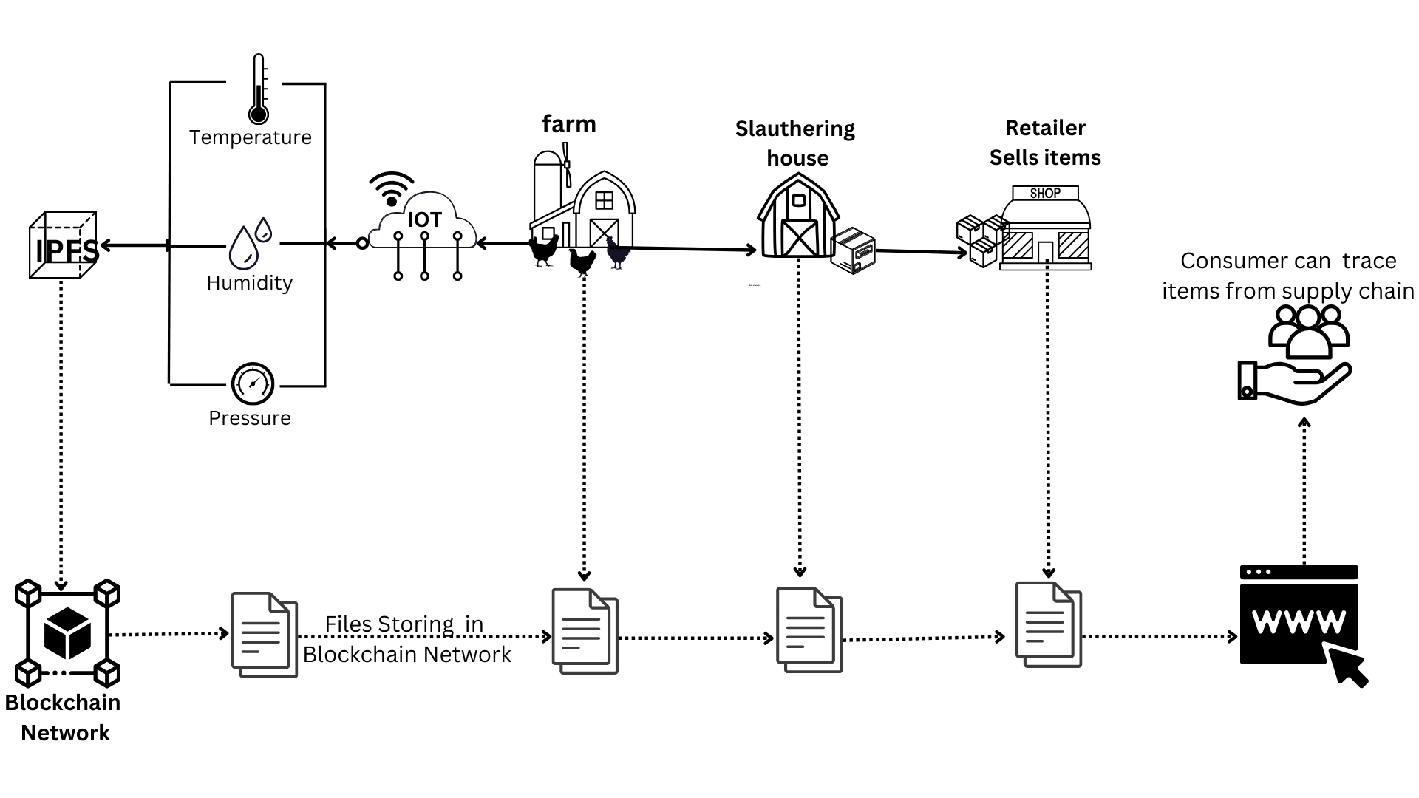
ARCHITECTURE OF PROPOSED SYSTEM

Slide 12
TECHNOLOGIES OF THE PROPOSED SYSTEM
HTML, CSS
JavaScript
Python
Machine Learning
IOT
Blockchain
Solidity
IPFS

Slide 13
POTENTIAL USERS
Poultry Farmers
Producers
Retailers
Consumers

Slide 14
UNIQUE FEATURES OF THE SYSTEM
Real-time Farm Monitoring
Blockchain-Based Registration
Smart Contracts
Abnormalities Detection (ML)
Application Dashboard
Livestock monitoring

Slide 15
DEMAND FOR PROJECT
The demand for this project stems from its ability to address critical issues in the agricultural sector, enhance transparency, and empower farmers with the tools and information needed for sustainable and resilient farming practices.
Efficiency and Automation
Health and Disease Management
Increasing Instances of Calamities
Technological Advancements in Agriculture
Global Health Concerns
DEPARTMENT OF COMPUTER SCIENCE AND ENGINEERING

Slide 16
REQUIREMENTS ANALYSIS
Functional Requirements
User Registration and Authentication :
- Enable users to create accounts by providing necessary information such as username, email, and password. Implement a secure login process to verify user identity, using credentials stored securely. Include features for password reset and update to enhance security and user convenience.
Livestock Monitoring with IoT :
- Incorporate IoT sensors to monitor vital parameters like temperature, humidity, and location in real-time. Establish a robust communication system for transmitting sensor data to a centralized server or cloud platform.
Alerts and Notifications :
- Specify the events or conditions that prompt an alert. Define how alerts are communicated (e.g., push notifications, email). Clarify any user actions required upon receiving an alert, ensuring a seamless response process.
Disease Diagnosis and Prevention :
- Integrate data sources such as medical records, symptoms, and diagnostic test results for comprehensive patient information. Implement advanced algorithms to analyze medical data, assisting in accurate disease diagnosis based on patterns and trends.
16

Slide 17
Blockchain for Data Security:
-Implement a blockchain-based decentralized ledger to securely store and manage sensitive data,ensuring immutability and transparency.
Transparent Processes with Blockchain:
- Utilize smart contracts to automate and enforce predefined business rules and processes, ensuring transparency and trust. Utilize blockchain's immutability feature to create a secure and unchangeable record of processes, preventing unauthorized alterations.
Scalability:
- Design the system to easily scale horizontally by adding more nodes, servers, or resources to distribute the workload efficiently. Implement a load balancing mechanism to evenly distribute incoming traffic across multiple servers, preventing bottlenecks and ensuring optimal performance.
Data Analytics and Reporting:
- Enable the integration of diverse data sources, including databases, APIs, and external systems, to provide a comprehensive dataset for analysis.

Slide 18
USER REQUIREMENTS
User Registration
- Include mandatory and relevant input fields for users during registration, such as username, email, and password, ensuring the collection of necessary information
Profile Management
-Implement privacy settings that empower users to control the visibility of their profile information, balancing transparency with user preferences.
Sensor Integration and Data Visualization
-Implement an alert system based on sensor thresholds, providing timely notifications to users when certain conditions or anomalies are detected.
Livestock Monitoring
-Integrate sensors to monitor vital health parameters of livestock, including temperature, heart rate, and activity levels, ensuring early detection of health issues.
18
18

Slide 19
Application Tracking
- Implement a secure registration process and user authentication to ensure authorized access to the application tracking system.
Integration Capabilities
- Provide robust Application Programming Interface (API) support to facilitate seamless integration with third-party applications and systems.
Data Security and Privacy
- Implement end-to-end encryption for data transmission and storage to protect sensitive information from unauthorized access.
Task Management
- Provide a user-friendly interface for creating tasks, allowing users to input details such as title, description, priority, and due date.
Alerts and Notifications
- Include features for users to acknowledge and confirm receipt of alerts, ensuring that important information is acknowledged and understood.

Slide 20
NON FUNCTIONAL REQUIREMENTS
Usability
Reliability
Security
Scalability
Interoperability
DEPARTMENT OF COMPUTER SCIENCE AND ENGINEERING
DEPARTMENT OF COMPUTER SCIENCE AND ENGINEERING
DEPARTMENT OF COMPUTER SCIENCE AND ENGINEERING
20
20

Slide 21
SYSTEM REQUIREMENTS
Software Requirements
IoT Monitoring System
Blockchain Platform
Machine Learning Algorithms
Hardware Requirements
Processor
RAM – 4 GB
Hard Disk - 20GB

Slide 22
PROCESS MODEL SELECTED
The integration of IoT (Internet of Things) and blockchain technologies in a poultry management system could follow an iterative and adaptive process model, such as the Agile model. This model allows for flexibility and continuous improvement, which is beneficial when dealing with emerging technologies like IoT and blockchain. Agile methodologies enable frequent reassessment and adjustments based on the evolving requirements and challenges in the integration process.

Slide 23
FEASABILITY
Economic Feasibility: Economically feasible if revenue aligns with costs.
Technical Feasibility: Technically feasible if tools are available, and the team has the necessary skills.
Behavioral Feasibility: Behaviorally feasible if users are engaged and willing to adopt features.

Slide 24
THANK YOU

